Slide 1

Mo Patel
Director, Artificial Intelligence
Think Big Analytics
Recommendation Systems
Wide & Deep
Beyond Search

Slide 2
Agenda
Introduction to recommendation systems
Traditional recommendation approaches
Introduction to Wide & Deep
Wide Learning in context of Wide & Deep
Deep Learning Fundamentals
Deep Learning for Recommendations
Preparing Data for Wide & Deep
Training Wide & Deep models
Serving Wide & Deep models
Champion-Challenger Approach to deployment
Tuning Wide & Deep models
Wrap-up and Summary

Slide 3

Recommendation Systems A brief history

Slide 4
Recommendation Systems A brief history
Notes:
Recommendation systems share roots with early communication. With the advent of communication in humans came the ability to share information and influence others.

Slide 5
Recommendation Systems A brief history
Notes:
Written language augmented word of mouth and the age of advertising was born

Slide 6
Recommendation Systems A brief history
Notes:
Through milennai the foundations of recommendation remainded pretty static: we do what others do. We buy what others buy. The influence of the group is paramount to adoption, whether it be a product, a service, a religion, or a political belief system. We buy because we are sold. Recommendations from others are at the root of those patterns.

Slide 7
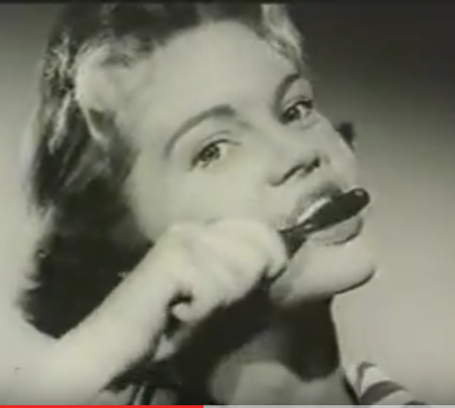
Recommendation Systems A brief history
Notes:
With mass communication came the ability to influence even more. Those early days of broadcast audio and video set the stage for Network Age refiniements.

Slide 8
Recommendation Systems A brief history
Notes:
With the browser came the ability to begin to track and influence search patterns. Proactive search with advertising is the essence of recommendation systems.

Slide 9
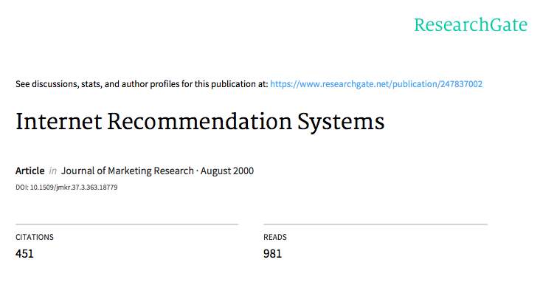
Recommendation Systems A brief history
Notes:
The seminal paper on Internet Recommendation Systems was published in 2000. Since that influential paper, the art and science of internet recommendation systems came to be.

Slide 10
Recommendation Systems A brief history
Notes:
And here we are nearly 2 decades later, with commercial AI options like TensorFlow, and the perfection of Internet Recommendation systems is upon us.

Slide 11
The value of recommendations
Netflix: 2/3 of the movies watched are recommended
Google News: recommendations generate 38% more clickthrough
Amazon: 35% sales from recommendations
Choicestream: 28% of people would buy more music if they found what they liked.
source: Recommender Systems (Machine Learning Summer School 2014 @ CMU
https://www.slideshare.net/xamat/recommender-systems-machine-learning-summer-school-2014-cmu

Slide 12
Traditional recommendation approaches
Collect data -> explicit/implicit/hybrid feedback
Learning phase -> prediction recommendation
Filtering
Content based
Collaborative
Hybrid
Notes:
Recommender systems are information filtering systems that deal with the problem of information overload filtering vital information fragment out of large amounts of dynami- cally generated information according to user’s preferences, interest, or observed behavior. Recommender systems aim for the ability to predict whether a particular user would prefer an item or not based on the user’s profile.
Recommender systems are defined as a means of assisting and augmenting the social process of using recommendations from others to make choices when there is not sufficient personal knowledge nor experiece of the alternatives. Personalized, user-specific exclusive content and service recommendations are the result.

Slide 13
Traditional recommendation approaches
Collect data -> explicit/implicit/hybrid feedback
information collection phase
learning phase
prediction/
recommendation
phase
Recommendation phases
Notes:
Traditional recommendation systems require collection of data from the outset. Relevant informant from users is needed to generate a user profile or model for prediction. The system needs to know as much as possible from the user in order to provide reasonable recommendations as soon as possible. Obviously, accurate models indispensable for creating relevant and accurate recommendations.
Explicit feedback comes directly form the user. Traditional approaches normally prompt users through a system interface to provide ratings of items in order to construct and improve the users’ model. The quality of the users’ input determines the accuracy of the model. The main shortcoming of this approach is it requires effort on the part of the user.
Implicit feedback can ben inferred by tracking users’ preferences by monitoring different actions such as purchase history, navigation history, time spent on web pages, links followed, email content and button clicks. Inferred from user behavior, implicit feedback data might be more objective that explicit feedback.
The strengths of both implicit and explicit feedback can be combined in a hybrid system in order to minimize their weaknesses and get a better performing system. This can be achieved by using an implicit data as a check on explicit rating or allowing users to give explicit feedback only when the user chooses to do so.

Slide 14
Traditional recommendation approaches
Learning phase -> prediction recommendation
source: Recommendation systems: Principles, methods and evaluation
Notes:
The Learning Phase implies a learning algorithm to filter and exploit the user’s features from the feedback gathered. The algo recommends or predcts what kind of items the user may prefer. This directly based on history or model, or indirectly based on the observed activities of the user. The use of efficient and accurate recommendation techniques is very important for a system that will provide good recommendation to its individual users. This explains the importance of understanding the features and potentials of different recommendation techniques. This image shows the anatomy of different recommendation filtering techniques.

Slide 15
Traditional recommendation approaches
Filtering
Content based
Collaborative
Hybrid
Notes:
Content-based technique is a domain-dependent algorithm and it emphasizes more on the analysis of the attributes of items in order to generate predictions. When documents such as web pages, publications and news are to be recommended, content-based filtering technique is the most successful. In content-based filtering technique, recommendation is made based on the user profiles using features extracted from the content of the items the user has evaluated in the past . Items that are mostly related to the positively rated items are recommended to the user. CBF uses different types of models to find similarity between documents in order to generate meaningful recommendations. It could use Vector Space Model such as Term Frequency Inverse Document Frequency (TF/IDF) or Probabilistic models such as Naı ̈ve Bayes Classifier, Decision Trees or Neural Networks to model the relationship between different documents within a corpus. These techniques make recommendations by learning the underlying model with either statistical analysis or machine learning techniques. Content-based filtering tech- nique does not need the profile of other users since they do not influence recommendation. Also, if the user profile changes, CBF technique still has the potential to adjust its rec- ommendations within a very short period of time. The major disadvantage of this technique is the need to have an in- depth knowledge and description of the features of the items in the profile.
Collaborative filtering is a domain-independent prediction technique for content that cannot easily and adequately be described by metadata such as movies and music. Collaborative filtering technique works by building a database (user-item matrix) of preferences for items by users. It then matches users with relevant interest and preferences by calcu- lating similarities between their profiles to make recommenda- tions. Such users build a group called neighborhood. An user gets recommendations to those items that he has not rated before but that were already positively rated by users in his neighborhood. Recommendations that are produced by CF can be of either prediction or recommendation. Prediction is a numerical value, Rij, expressing the predicted score of item j for the user i, while Recommendation is a list of top N items that the user will like the most.. The technique of collaborative filtering can be divided into two cate- gories: memory-based and model-based.
Hybrid filtering technique combines different recommendation techniques in order to gain better system optimization to avoid some limitations and problems of pure recommendation sys- tems. The idea behind hybrid techniques is that a com- bination of algorithms will provide more accurate and effective recommendations than a single algorithm as the disadvantages of one algorithm can be overcome by another algorithm

